Slide 1
Biochem: Proteins Intro

Slide 2
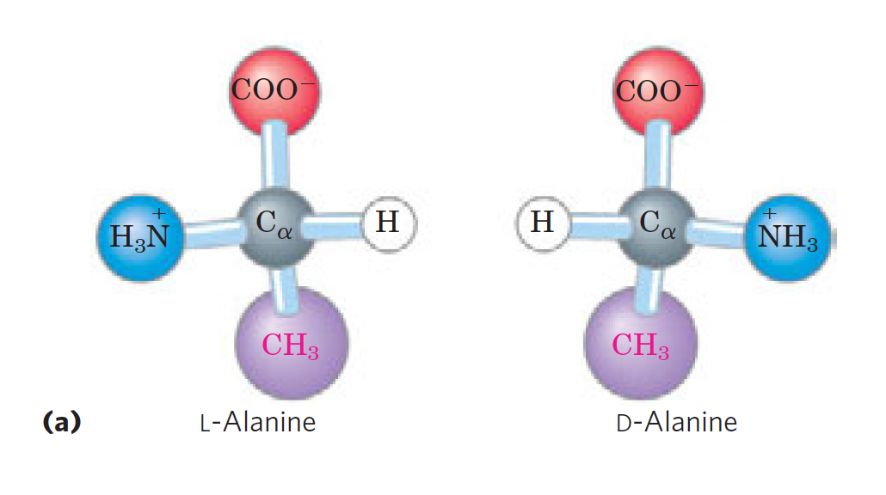
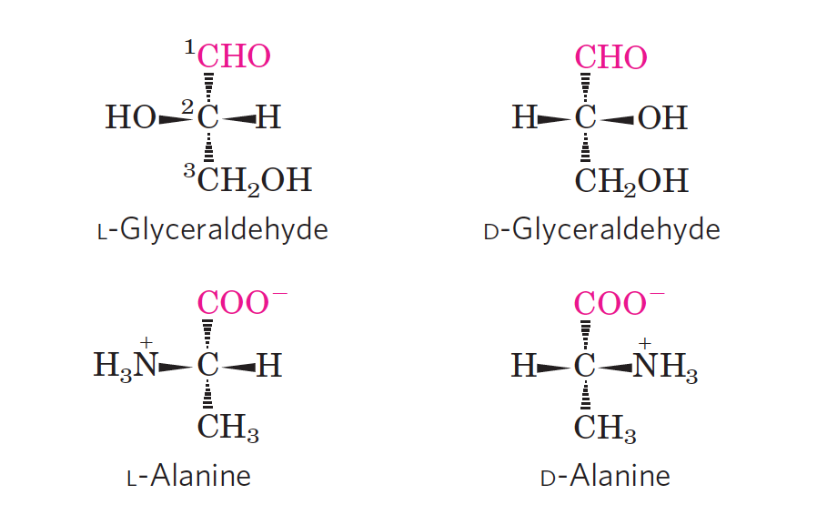
chirality
C_{ɑ} is chiral center
Structural isomer (specifically enantiomer)
D,L system
L and D designations were used for levorotatory (rotating plane-polarized light to the left) and dextrorotatory
(rotating light to the right). → not completely accurate

Slide 3
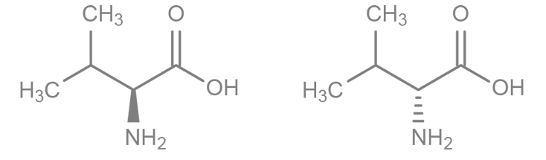
Which isomer of Valine is shown to the RIGHT?
L
D
Notes:
Answer: D

Slide 4
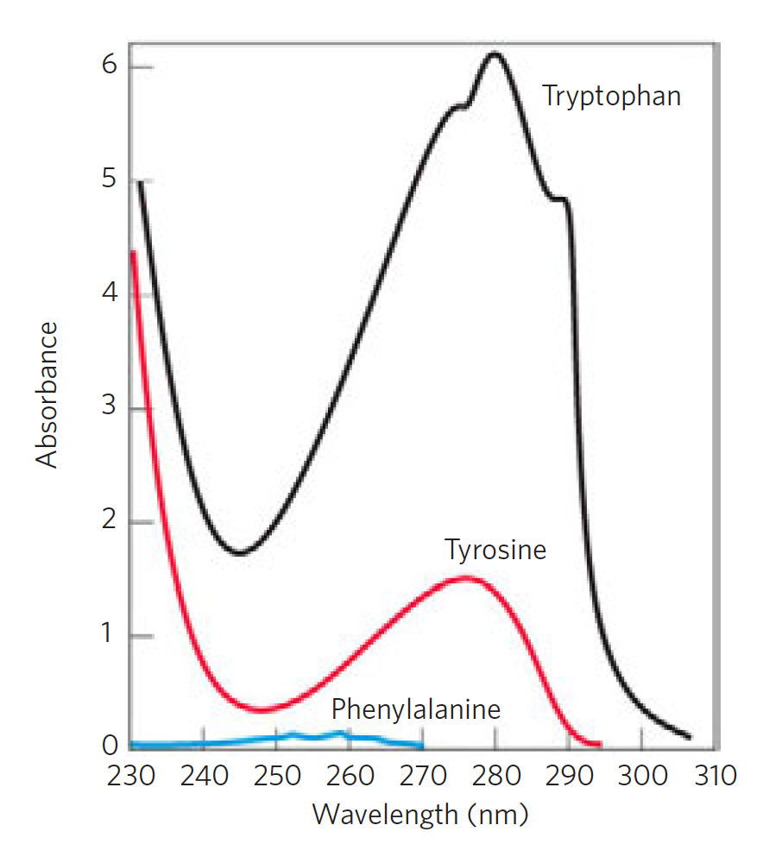
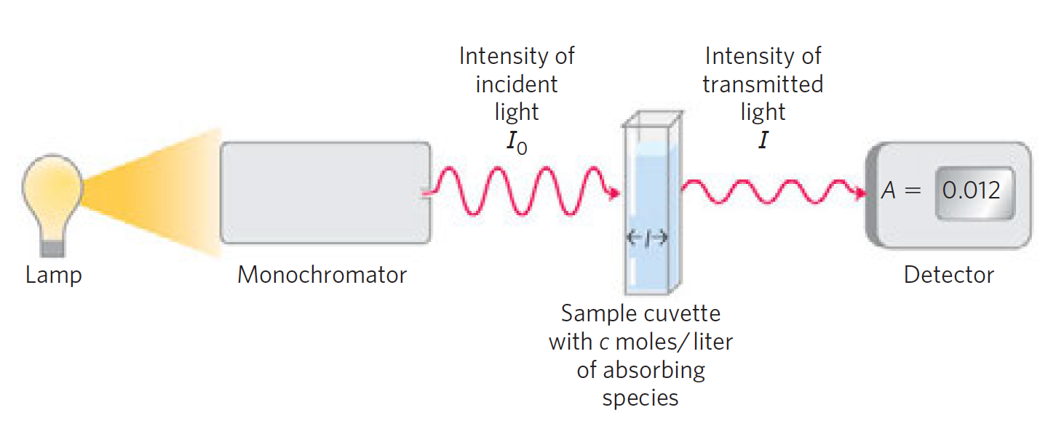
Lambert-beer Law
Aromatic amino acids display absorbance b/c of ring structure.
I/I₀ = T
log(1/T)= A
A = 𝜺cl

Slide 5
While analyzing the concentration of a solute using spectrophotometer analysis, I accidentally smudge the cuvette with my fingers. If I measure the intensities of light before and after passing through the cuvette, how will my concentration reading be affected?
The measured concentration will be higher than the actual concentration because more light will be able to pass through.
The measured concentration will be lower than the actual concentration because more light will not pass through the cuvette as much as if it were clear.
The measured concentration will be lower than the actual concentration because more light will be able to pass through.
The measured concentration will be higher than the actual concentration because more light will not pass through the cuvette as much as if it were clear.
Notes:
Answer: D

Slide 6
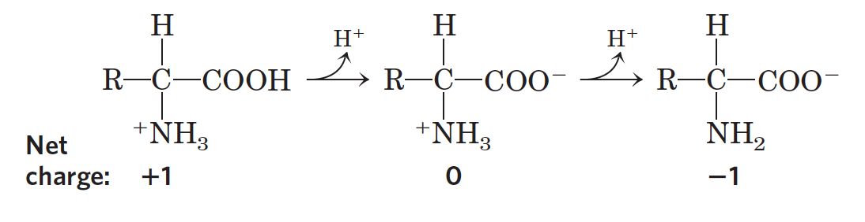
A/B for Amino Acids
A.A exist as zwitterions often → charged parts, net charge 0
Amphoteric (acid and base) properties
A/B properties useful in practice (titration)

Slide 7
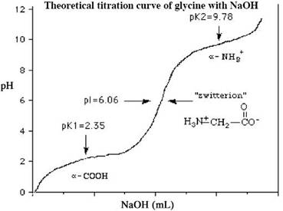
Titration
Important points
Half-equivalence point 1 (pK₁)
Equivalence point = ISOELECTRIC POINT (pI)
Half-equivalence point 2 (pK₂)
REVIEW TITRATION CURVES AND DEFINITIONS: http://webhost.bridgew.edu/c2king/CH241/Lec7_Ch11_AcidBase%20Titn.pdf
Oftentimes, more complex (pI not always “simple avg”)

Slide 8
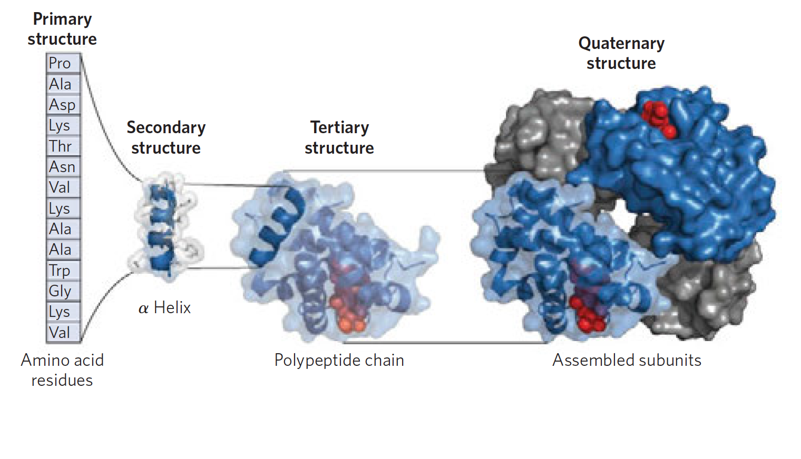
Structure Hierarchy

Slide 9
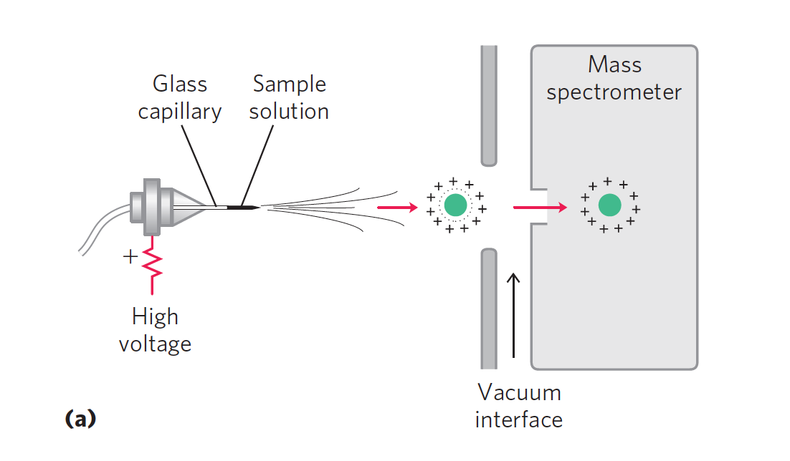
Mass Spectrometry (analyzing mass)
Requires gas phase
matrix-assisted laser desorption/ionization mass spectrometry, or MALDI MS
Uses pulse of laser to ionize protein and convert to gas phase with minimum breakdown
electrospray ionization mass spectrometry, or ESI MS
solution of analytes is passed through a charged needle that is kept at a high electrical potential, dispersing the solution into a fine mist of charged microdroplets (liquid evaporates)

Slide 10
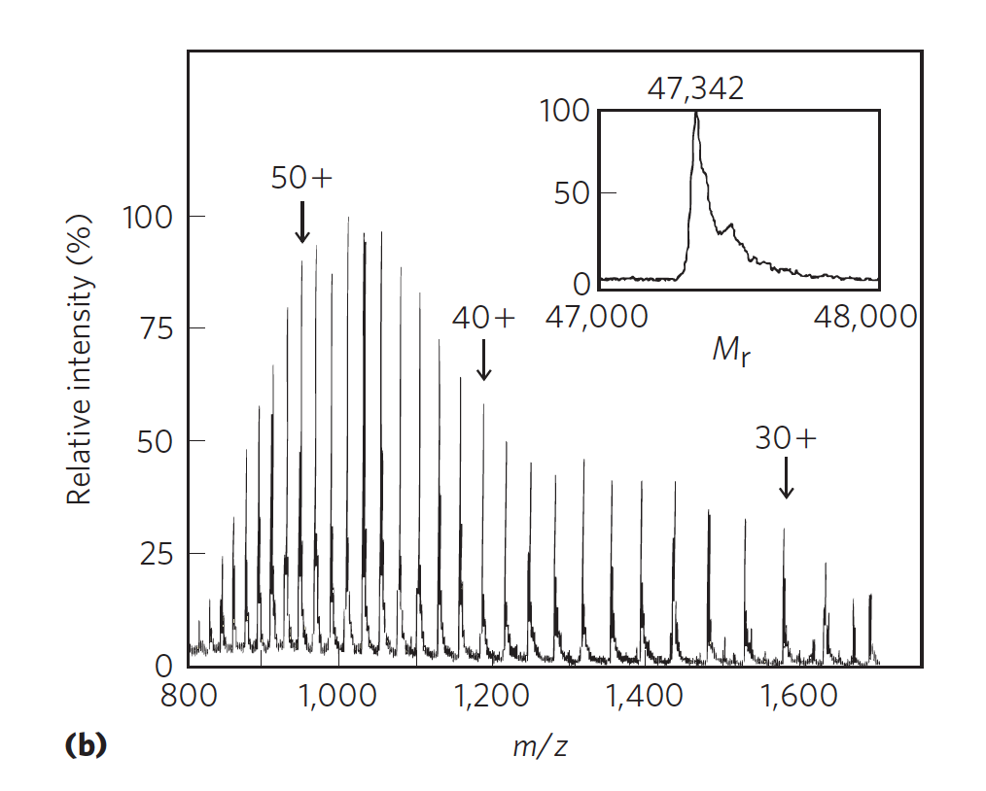
“Each successive peak corresponds to a species that differs from that of its neighboring peak by a charge difference of 1 and a mass difference of 1 (1 proton). The mass of the protein can be determined from any two neighboring peaks.” (Lehninger)

Slide 11
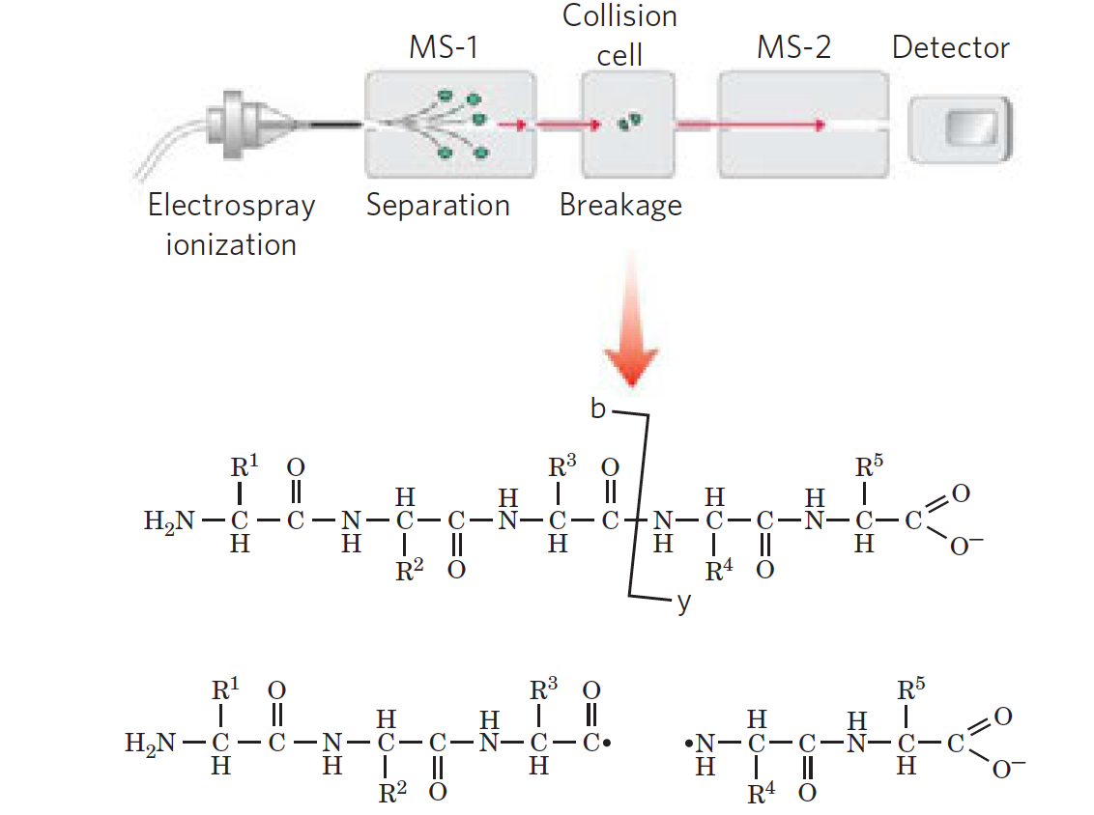
Tandem MS (or just MS/MS) for sequencing
Protein is “chopped” by proteases
Fragments go to second one and are broken on the way by collision with other gases

Slide 12
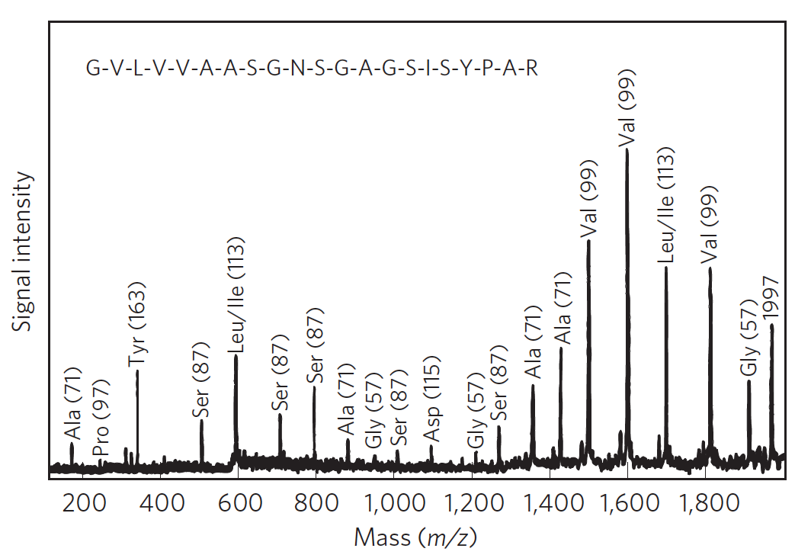
Difference used to identify A.A

Slide 13
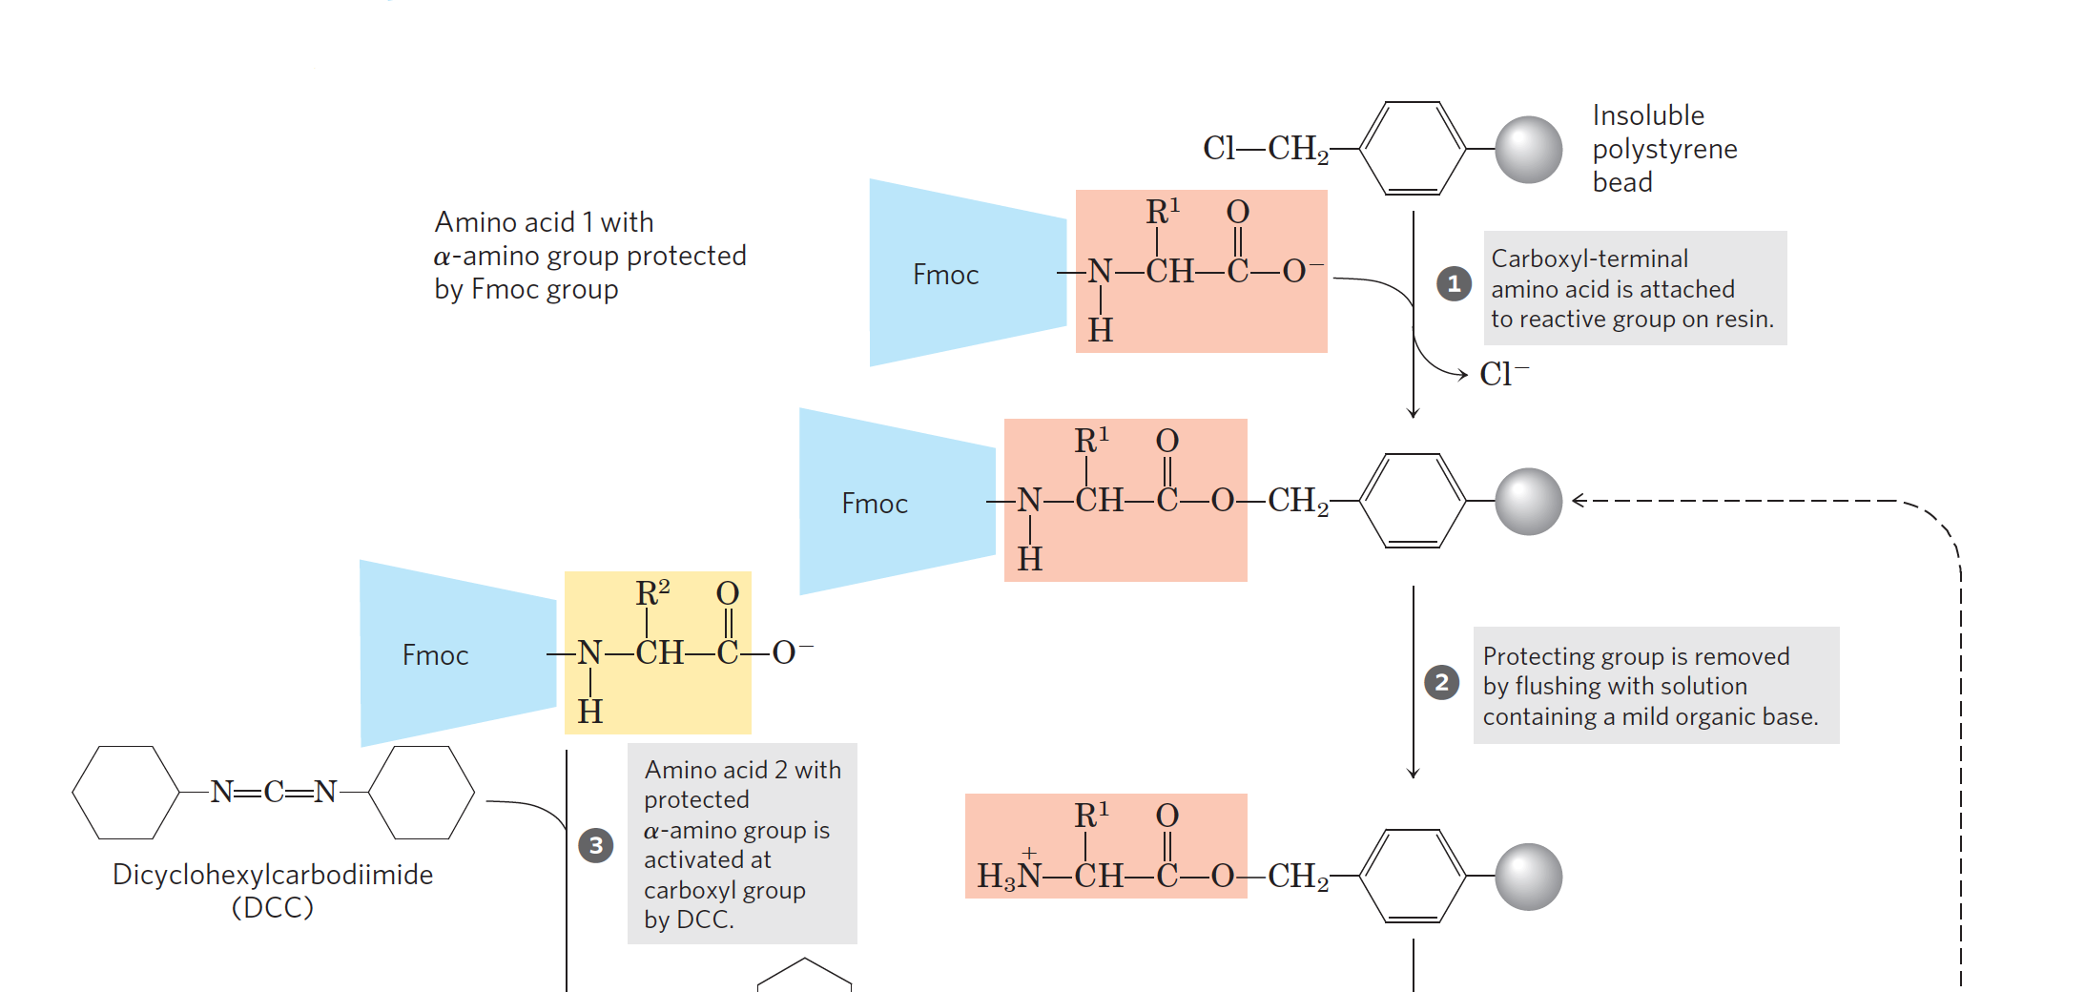
Protein Synthesis

Slide 14
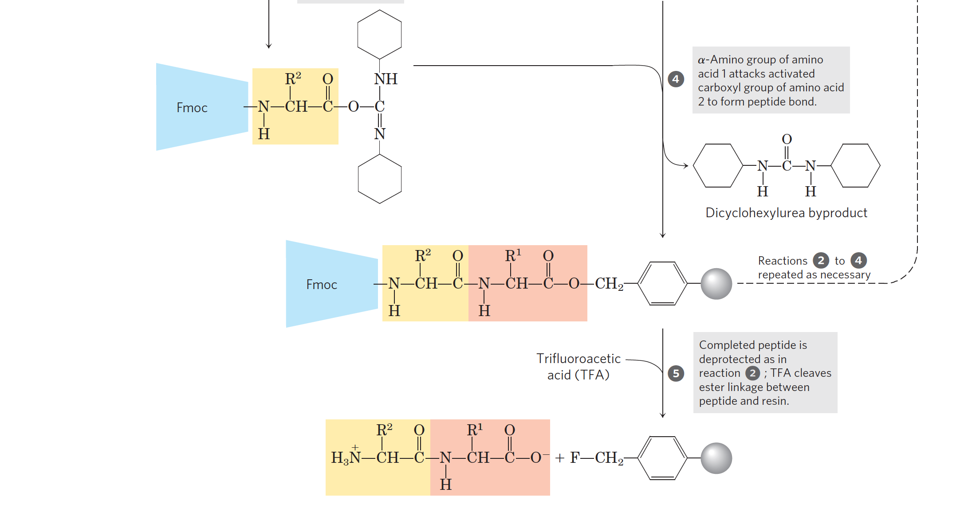

Slide 15
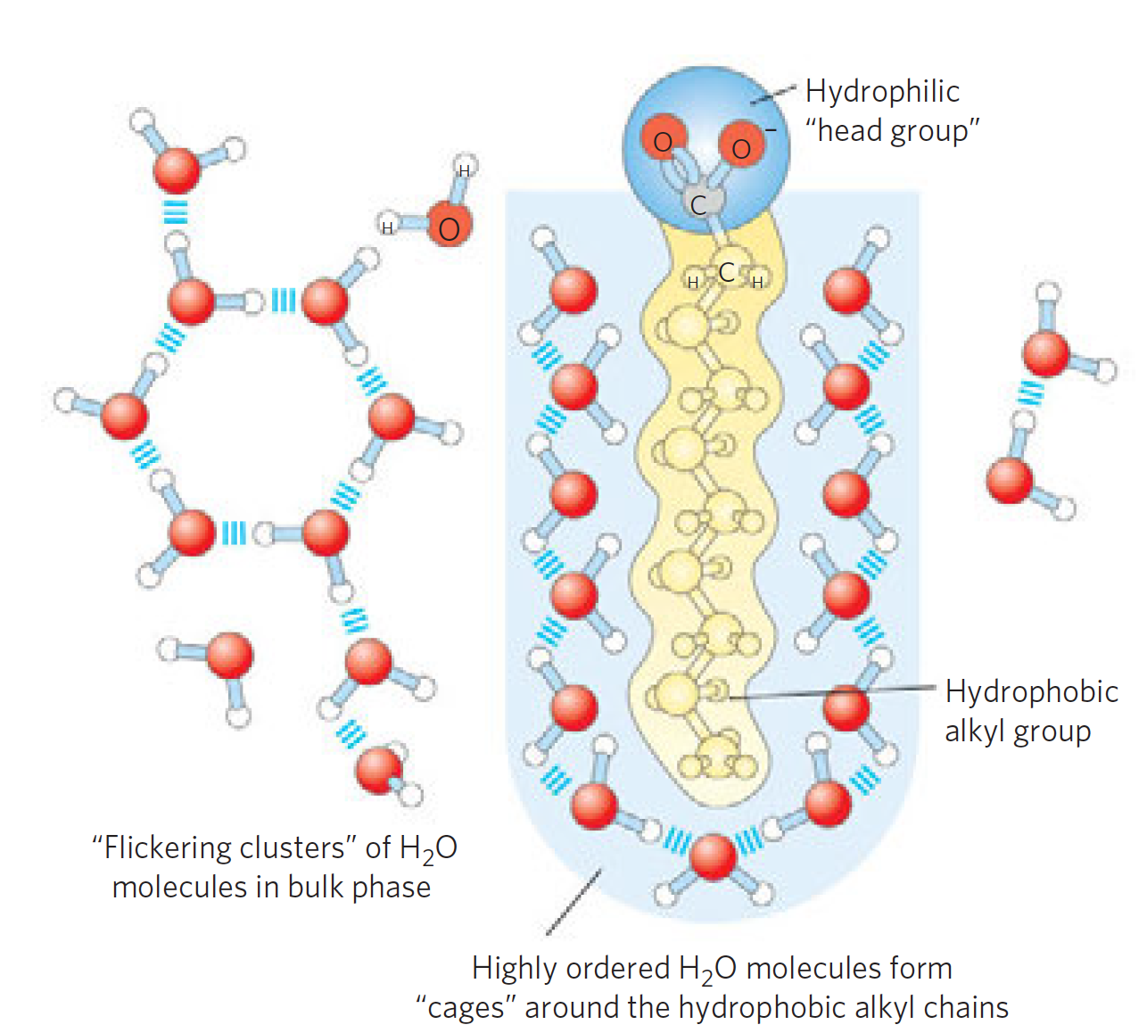
Interactions in Proteins depend on Interactions
Minimize G
Native (functional) configuration lower by ~ 65 kJ/mol
Hydrophobic on interior b/c enthalpy and entropy
Paired interactions vs nonpaired
Solvation layer

Slide 16
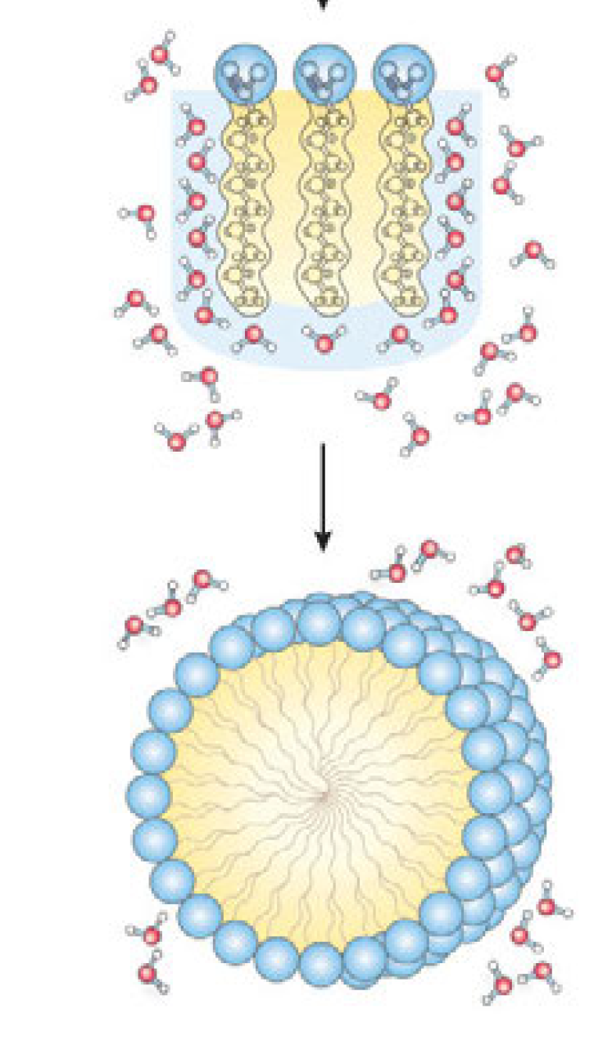
BIG IDEA:
Disorder + Strong Bonds → FAVORABLE

Slide 17
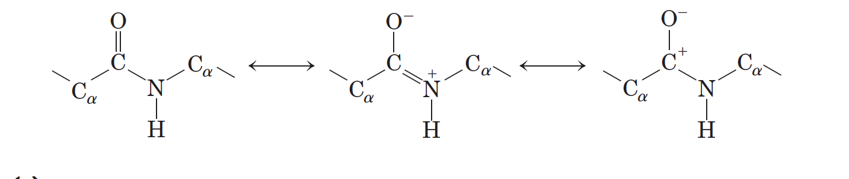
N-C_{ɑ} bond of >1 Order
Observation shows the bond is higher than order 1 because of resonance so no rotations is allowed (due to N’s lone pair)

Slide 18
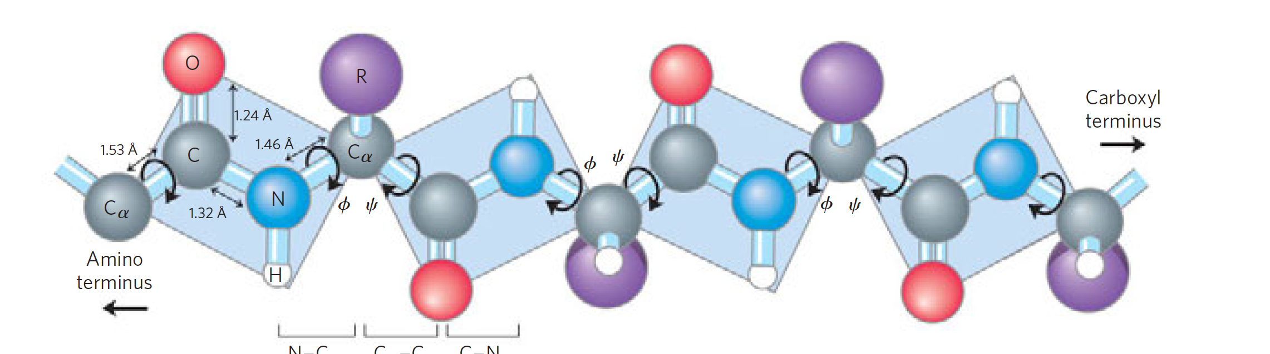
Dihedral angles
Imagine plane here

Slide 19
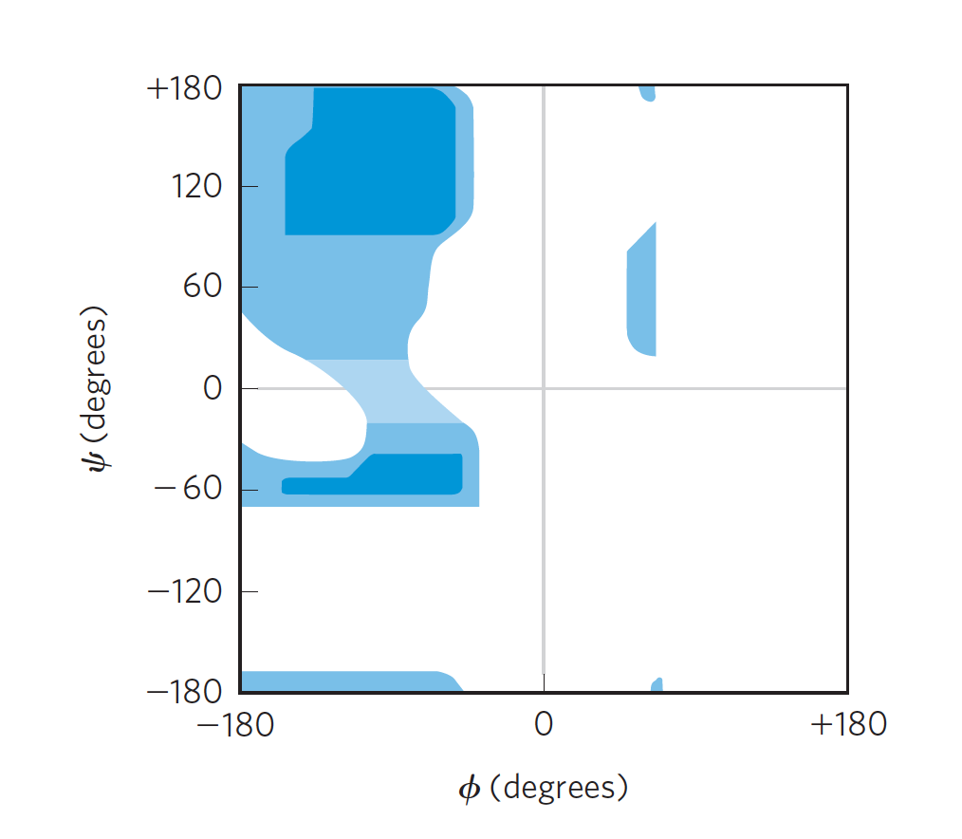
Ramachandran plot
Steric effects (e⁻/e⁻ repulsions restrict possible dihedral angles)

Slide 20
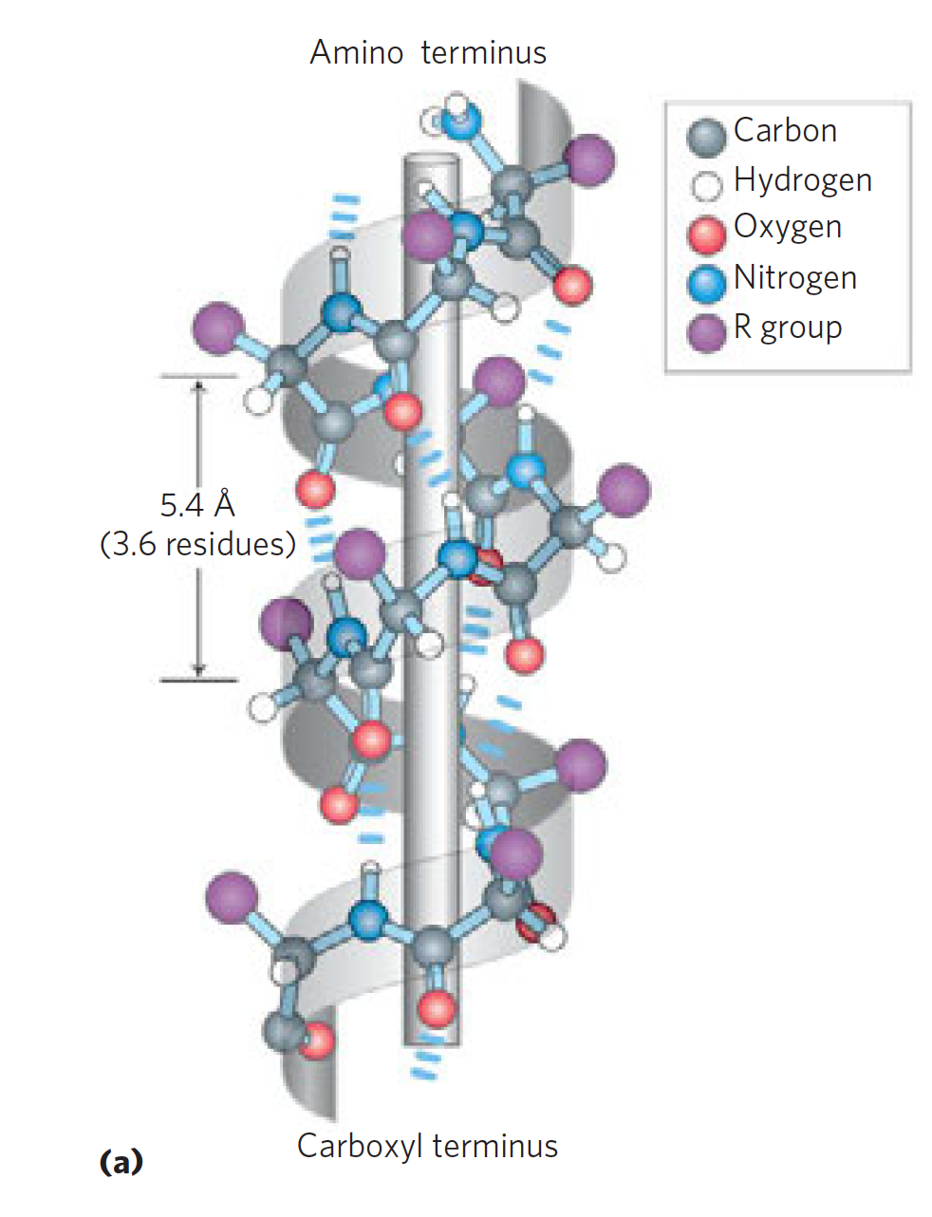
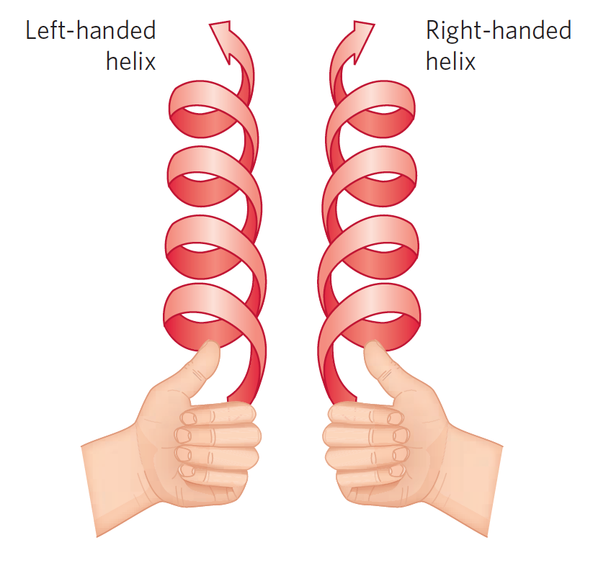
Secondary Structure: α-helix
H-bonding between amine and C.A = stability
L OR D (not both)
L left handed
D right handed

Slide 21
α-helix not always possible: Factors
(1) the intrinsic propensity of an
amino acid residue to form an helix (ion repulsion)
(2) the interactions
between R groups, particularly those spaced three
(or four) residues apart
(3) the bulkiness of adjacent R
Groups
(4) the occurrence of Pro and Gly residues (destabilizing)
(5) interactions between amino acid residues at the
ends of the helical segment and the electric dipole
inherent to the helix

Slide 22
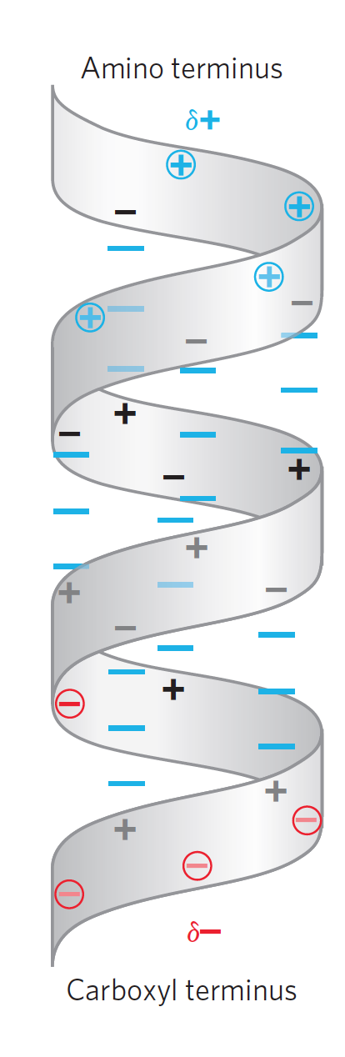
“Inherent dipole” factor
+ charge favored at COOH
- charge favored at amino

